Slide 1


Inspire2Vote at the YMCA
KY Voter Registration 101

Slide 2
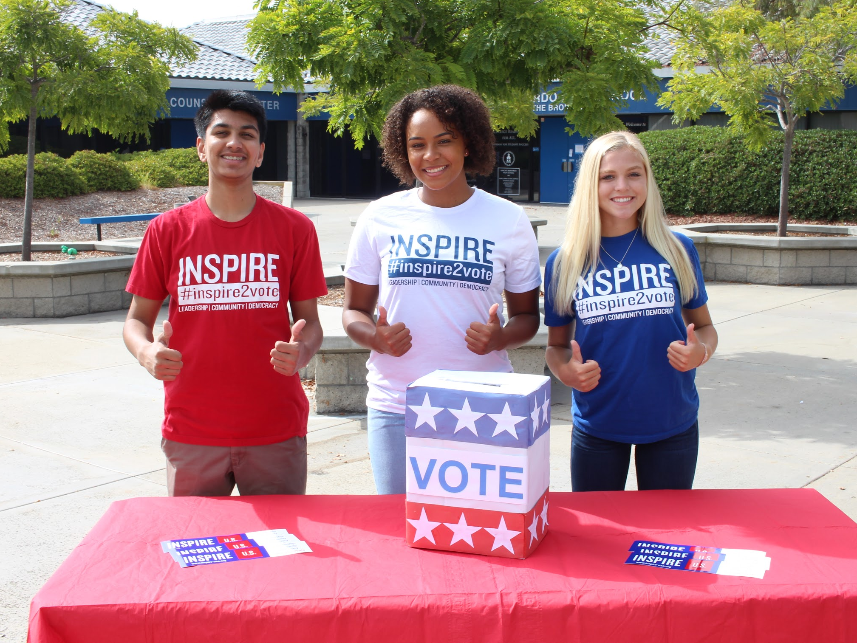
What is Inspire2Vote?
Inspire2Vote is a nonpartisan program that works to transform young leaders’ inspiration into action that improves our communities and strengthens our democracy.
The vision: In 2020, the US will see amplified representation of young people who are informed, confident, empowered and actively participating in the election process.
Notes:
National. Nonpartisan. Peer to Peer focus in high schools
Inspire has a long history of partnering with the KY YMCA - we are excited to support you to make sure that students in your high school have the opportunity to register to vote and be heard in each election!

Slide 3
Youth Voter Turnout in the United States
Notes:
To start things off, we’re going to talk about how young people have typically participated in elections compared to older elections. Would anyone like to take a guess at average participation rates for 18 year olds? For 65 years and older?

Slide 4
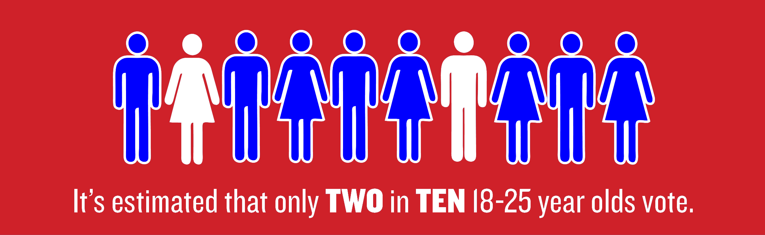
Youth voters are under-represented
In the 2018 Election…
  22% of 18-19 year olds voted
  65+ voted at a rate of 66%
Notes:
In 2018 - 22% of 18-19 year olds voted (that’s two out of every 10 people!) By comparison, people ages 65 or older voted at a rate of 66%. Three (3) TIMES HIGHER. What do you think happens when voter turnout looks this way across age groups?

Slide 5
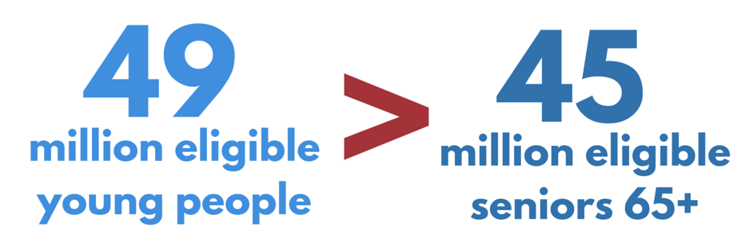
Power in NUMBERS
5 million American Citizens turn 18 each year. By 2020, this age group is projected to be the largest voting bloc.
.
Notes:
.5 million young people turn 18 every single year - by 2020, young people will be the largest voting bloc in the entire country! You and your peers are part of a powerful group! That’s why it’s so important to actually get to the polls and make your voices heard! Every vote matters - In Virginia in 2017, a house of delegates seat was a tie and had to be determined by pulling a name out of a bowl. This decision flipped the house to a Republican majority. For more examples - https://www.npr.org/2018/11/03/663709392/why-every-vote-matters-the-elections-decided-by-a-single-vote-or-a-little-more

Slide 6
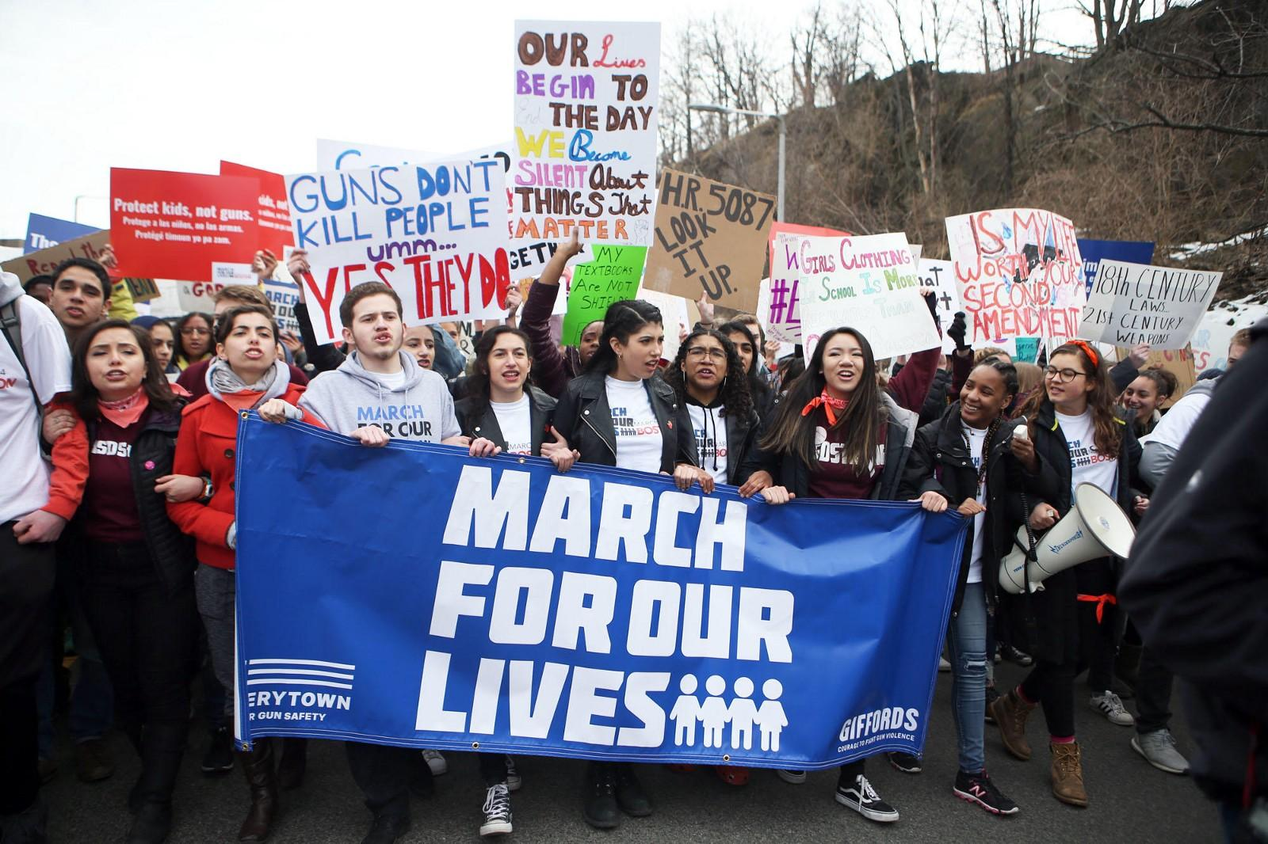
Youth Voter Movement
Historically young people have been at the forefront of change.
How are young people engaged now?
Notes:
How have you seen young people around you speak up or become politically active about issues they care about?

Slide 7
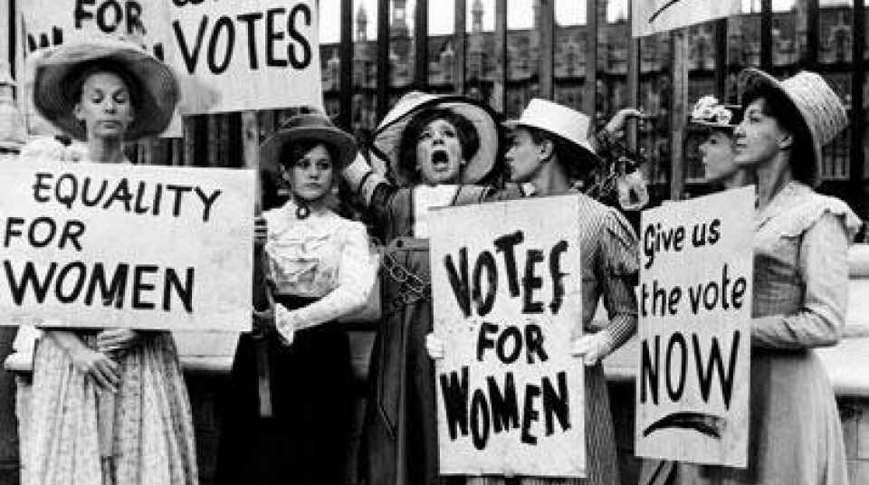
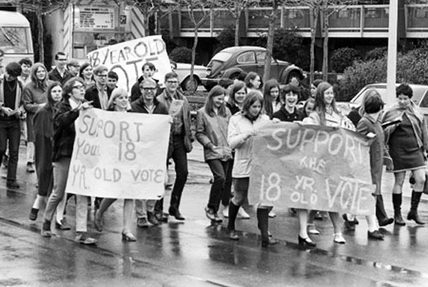
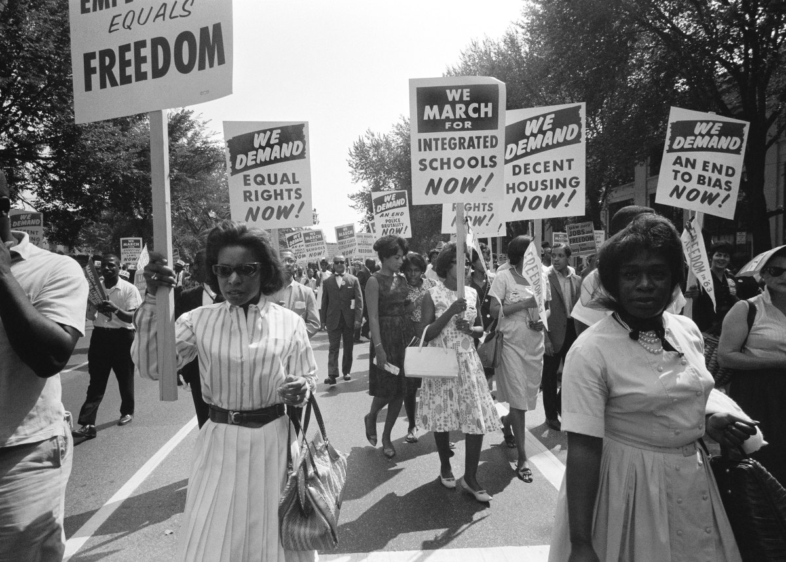
Youth Voter Movement
Notes:
Young people have advocated for change throughout history! During the Vietnam war, young people protested for their right to vote. At the time, the voting age was 21 and young people were being drafted at the age of 18. The Civil Rights Movement also had young leaders who worked to ensure more equitable rights for people of color. The same is true for the women’s suffrage movement, which helped women get the right to vote 100 years ago.

Slide 8
Be heard at the polls...Register to Vote
Notes:
You can be a DIFFERENCE MAKER in the youth movement by helping register your classmates to vote! This is an important opportunity to help those around you have their voices heard in upcoming elections to help influence the world you want to see.
Students who register to vote through Inspire2Vote at their high schools are 2x more likely to vote in elections!

Slide 9
Registering Peers to Vote
Classroom presentations— Schedule and lead 15-30 minute classroom presentations where eligible seniors and juniors can register and learn about Kentucky voter laws.
Centralized Drive— Set-up a voter registration station in your library or computer lab, then have teachers bring classes at assigned times throughout the day.
Senior Assemblies— Work with your principal to hold a school-wide drive, and present to your full senior and junior classes
Online/Text voter registration event— Plan and promote a digital voter drive, where students are encouraged to text-to-register or register online the same day.
  Text REGISTER to 760-957-9224
Notes:
Here are a few examples of voter registration drives that have been really successful at schools in the past. It can be helpful to find opportunities where there are a lot of students in one place - like a classroom or a school assembly.
Classroom Best Practices: Think about a class that ALL seniors must take, like social studies or homeroom. Try to work with the teachers in to organize all classroom presentations to occur in one week.
Library If your library has computers, even better, do online voter registration: www.inspire2vote.org/register
Best Practices: Staple the pledge to vote cards onto the voter registrations forms and hand them out to EVERY student as they walk into the assembly. Be organized and make sure you check every voter reg form as students turn them into you.
Text Reg Best Practices: Present to a captive audience and walk them through the online voter registration form
TRY TO CREATE MORE OPPORTUNITY FOR QUESTIONS ETC

Slide 10
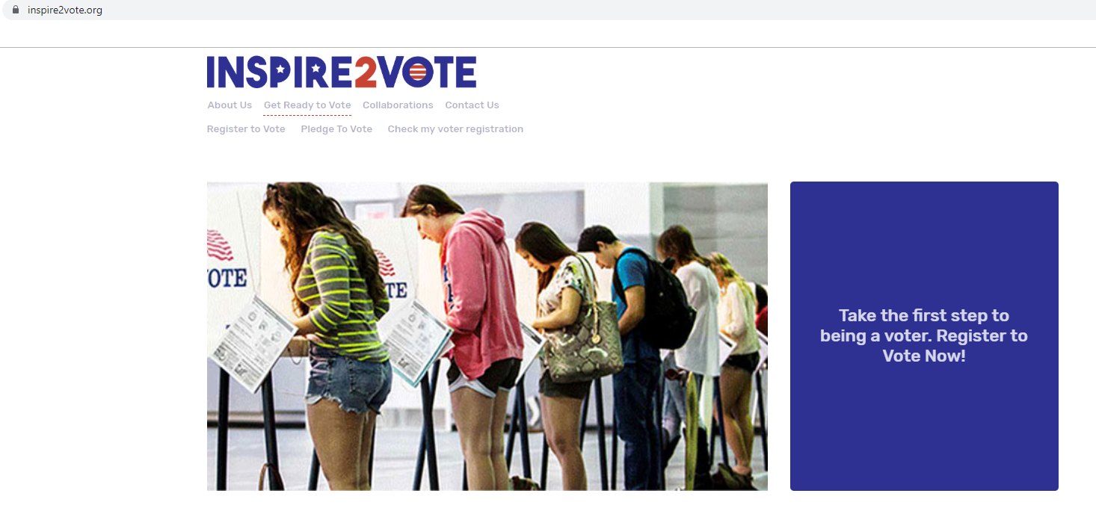
Get Started: REGISTER TO VOTE!
Notes:
To register to vote online -
Go to inspire2vote.org to start!

Slide 11
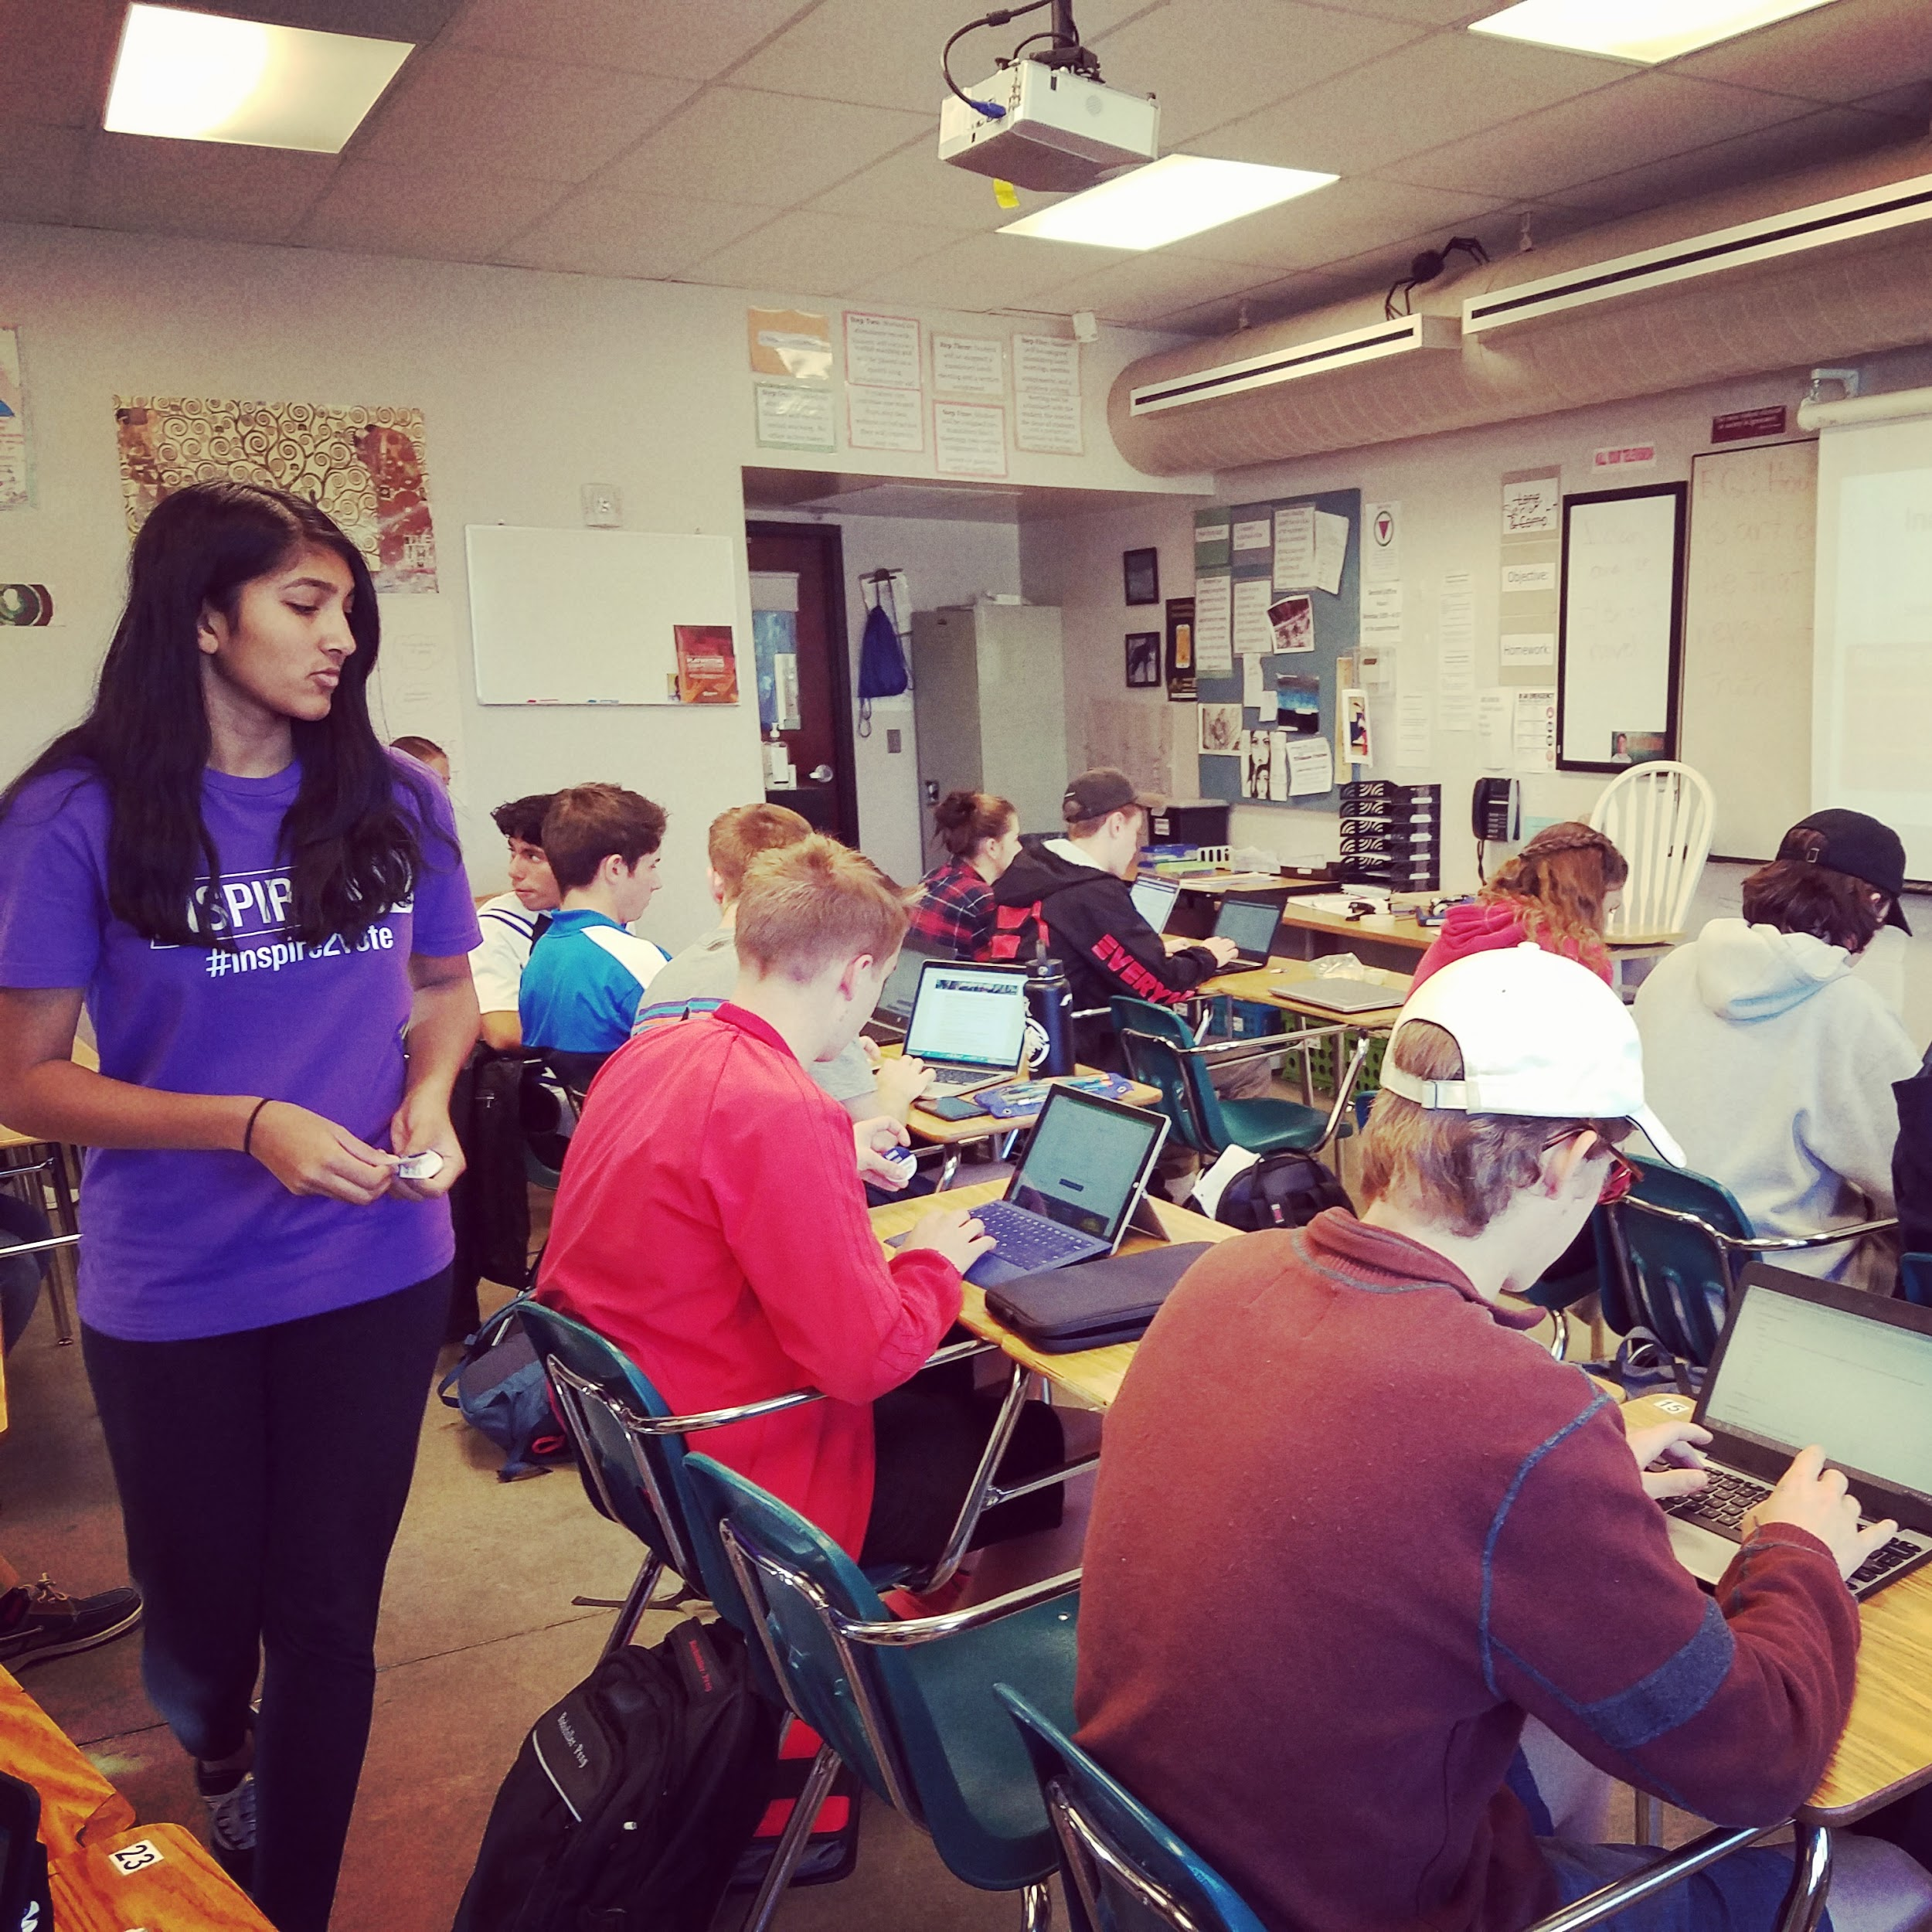
Who is Eligible to Register to Vote?
To register to vote in Kentucky you must meet the following criteria:
Be a U.S. citizen and resident of Kentucky
Be 18 years old on or before November 5th, 2019
Have your full Social Security Number
Pick a party affiliation
Kentucky has Closed Primaries - what does this mean?
Notes:
A closed primary means that you have to register to a political party in order to vote in that party’s primary.
If you are 17, but will be 18 on or before the next general election date you can register NOW.

Slide 12
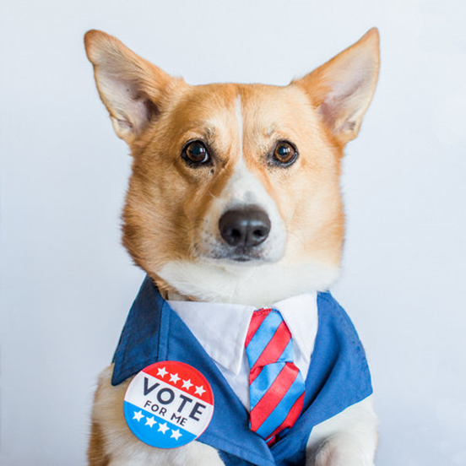
What Does it Mean to be Nonpartisan?
When registering others to vote, it’s essential to remain nonpartisan.
Do not recommend any political party or advocate for a particular issue.
Inspire2Vote is 100% nonpartisan
Notes:
Things to keep in mind when you are having a Voter Registration Drive is that you need to remain nonpartisan...
If someone is very passionate about a party or issue, that is great! No need to dismiss their enthusiasm. By remaining nonpartisan all students’ voices and concerns are respected.
What can you do if someone asks you which party you chose or which party they should register with??

Slide 13
Online Registration is SIMPLE!
Online Voter Registration Requirements
Full Social Security Number
Date of Birth
Always start on Inspire2Vote Website!
www.inspire2vote.org/register
Text2REGISTER”
Text the word “Register” to 760-957-9224
to receive a link to our online registration page directly to your phone!
Remind students to bring their social security number to register to vote!

Slide 14
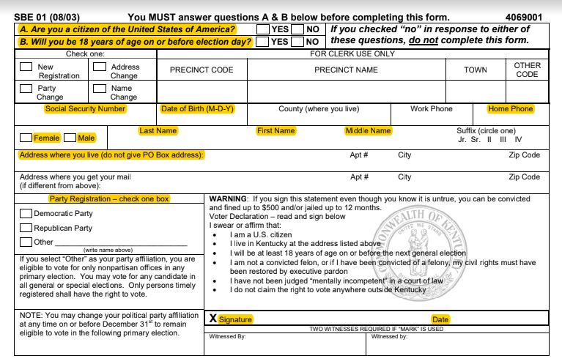
Notes:
Must be 18 by Nov. 5, 2019 - KY Governor’s Race
Keep an eye out for incomplete forms!
Make sure you check that students have put their full social security number and have registered for a party!

Slide 15
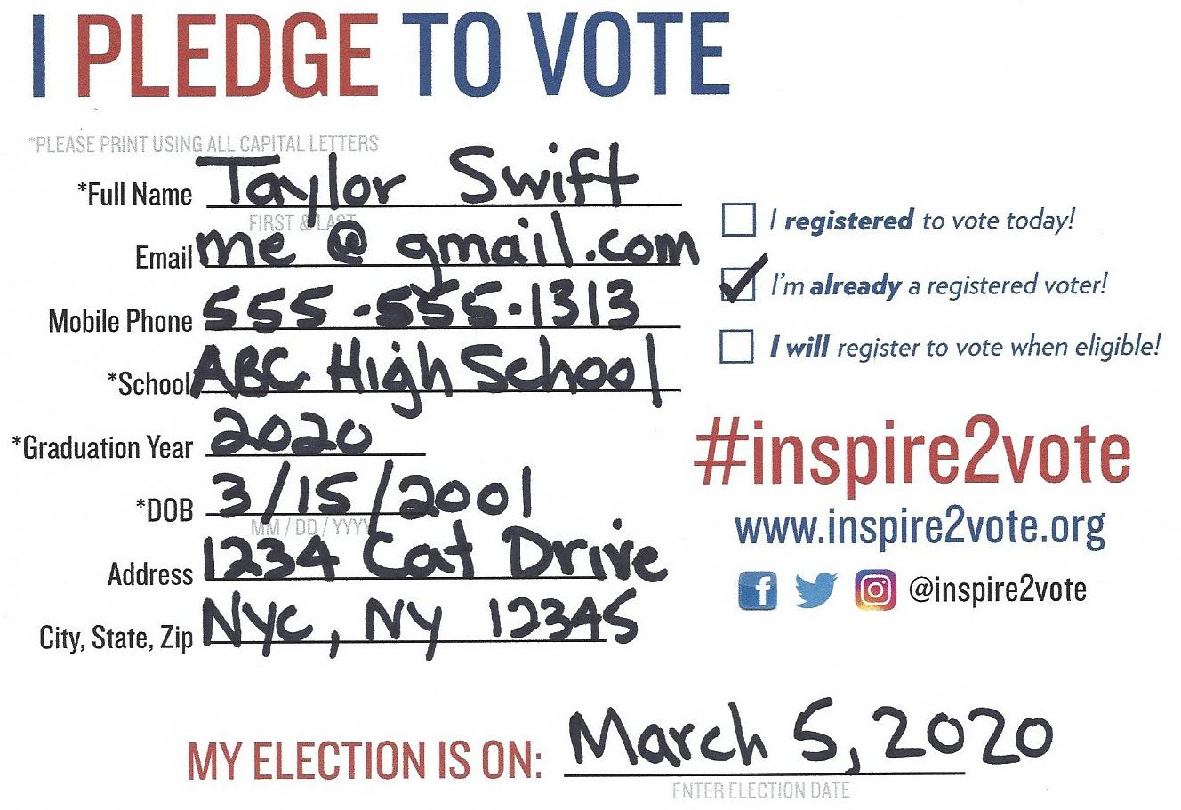
Pledge to VOTE!
If you were registered to vote before today, check this box!
If you just registered, check this box!
Want to promote voter engagement at your school or more info about upcoming elections? Check these boxes!
If you are not eligible to register or pre register today, check this box!
Notes:
Paper Pledge Card for Paper Voter Registration Drives Only!
Pledge cards go to everyone, even those who are already registered to vote or those who aren’t eligible to register.
“Pledge to Vote” cards are used for several reasons:
To track for the SoS award--gives us an accurate count of the percentage of students who are registered to vote out of the senior class
We use them to send election reminders
By using the card we are able to engage everyone and stay inclusive--even if they’re already registered or no eligible
The card is an actual pledge to vote--we want students to stay civically engaged and take the next step after registering by getting to the polls and voting. The pledge cards holds students accountable to get to the polls

Slide 16
Important Deadlines in Kentucky
October 7, 2019— Last day to register to be eligible to vote in the General Election
November 5, 2019— General Election Day, polls open 6am-6pm
April 20, 2020 - Last day to register to be eligible to vote in the Primary Election
May 19, 2020 - Primary Election, polls open 6am-6pm

Slide 17
FAQs: Voting in Kentucky
What if I’m going to college in the Fall?
  You can vote Absentee by contacting your county clerk!
What do I need to bring to the Polls on election day?
  You need to bring an ID to the polls in order to vote. Acceptable forms of ID include: driver’s License, social security card, credit card, any state issued ID with a photo
Where do I vote?
  You can find your designated polling location at GoVoteKY.com
Notes:
Absentee voting--students can find their county clerk at the KY Board of Elections website
More info on absentee voting can be found here!
A full list of acceptable IDs:
personal acquaintance of precinct officer,
driver’s license,
Social Security card,
County issued identification card approved in writing by the State Board of Elections,
U.S. government-issued identification card,
Kentucky state government-issued identification card with picture,
credit card, or
another form of ID containing both picture and signature
Other FAQs for election day in KY can be found here!

Slide 18
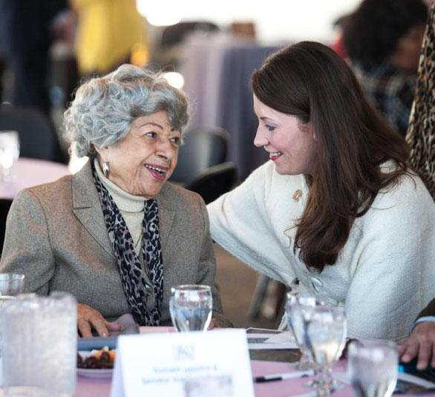
Georgia Davis Powers Award
If you register 75-100% of eligible seniors you may qualify for the Georgia Davis Powers Award from Kentucky's Secretary of State.
Gold Award: 100% of seniors registered to vote
Silver Award: 90% of seniors registered to vote
Bronze Award: 75% of seniors registered to vote
Georgia Davis Powers was the first African-American and woman elected to the Kentucky State Senate
Notes:
Let’s help your school earn this award this year!

Slide 19
Important Steps
HIGH SCHOOL SIGN UP
www.inspire2vote.org/ky_highschool_signup
REQUEST VR MATERIALS
www.inspire2vote.org/vr_order_form
HOST YOUR VOTER REGISTRATION DRIVE (VRD)
Remind students to know their SSN
Pledge cards need to be completed to track for the Georgia Davis Powers Award
REQUEST YOUR PRE-PAID LABEL TO MAIL BACK YOUR MATERIALS
AT LEAST 3 DAYS AFTER YOUR VRD
VR Forms are sent to Elections Office
Pledge Cards sent to Inspire2Vote
VOTER ENGAGEMENT AND GOTV
PRIMARY ELECTION MAY 21

Slide 20
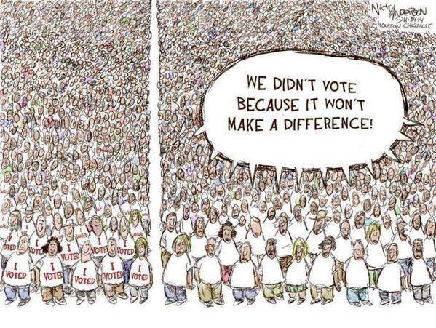
Questions?
KY YMCA Program Coordinator
Rianna Ayala
Frankfort, KY
rianna@kyymca.org
Inspire2Vote Contact:
Rebecca Arrington
rebecca@projecthighhopes.org

