Slide 1

Register to Vote ... Pledge to Be Heard!
Notes:
This presentation is a visual aid to accompany the Inspire U.S. Teacher Toolkit Module 1

Slide 2
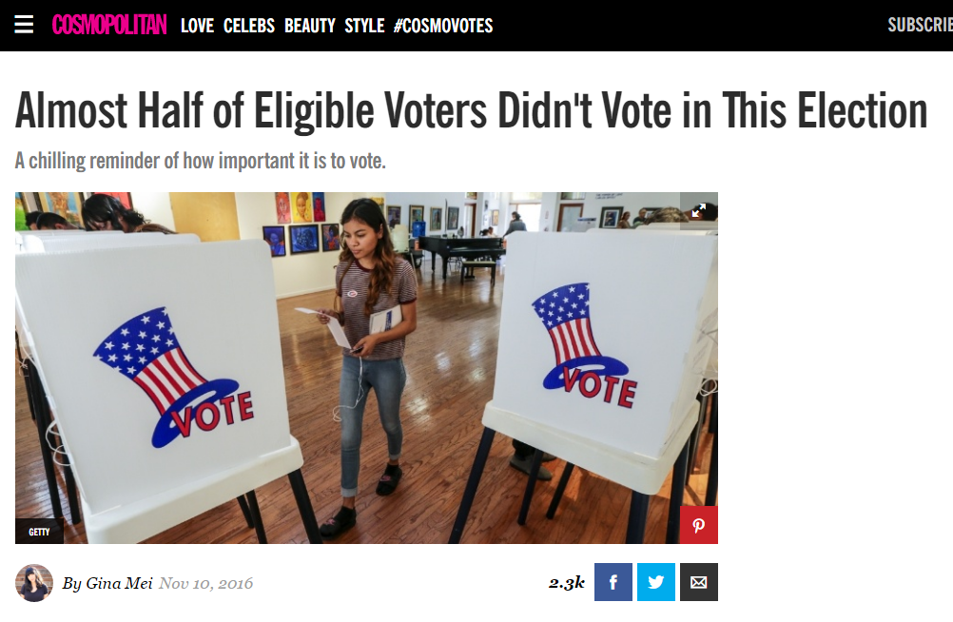
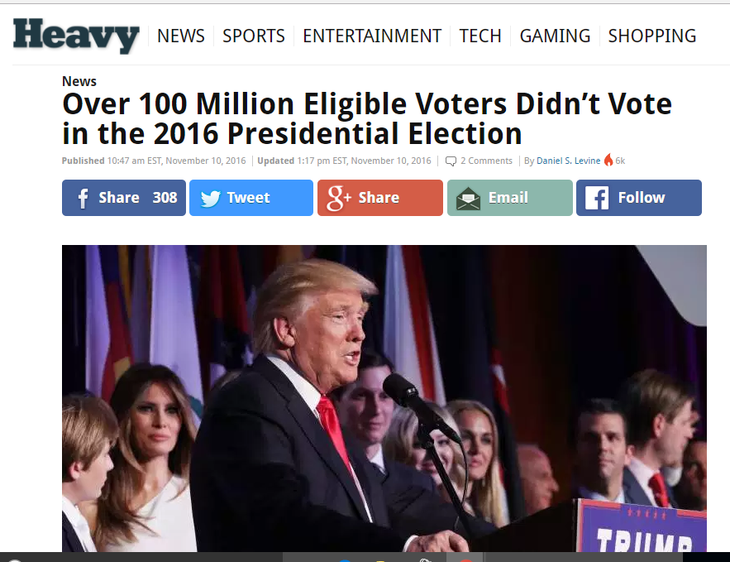
What’s at Stake?
100 million eligible voters didn’t vote in 2016...almost 50%!
41 million eligible voters aren’t even registered to vote.
Notes:
“I’m about to impress you with some facts and statistics. Trust me. Millions of people aren’t voting!”

Slide 3
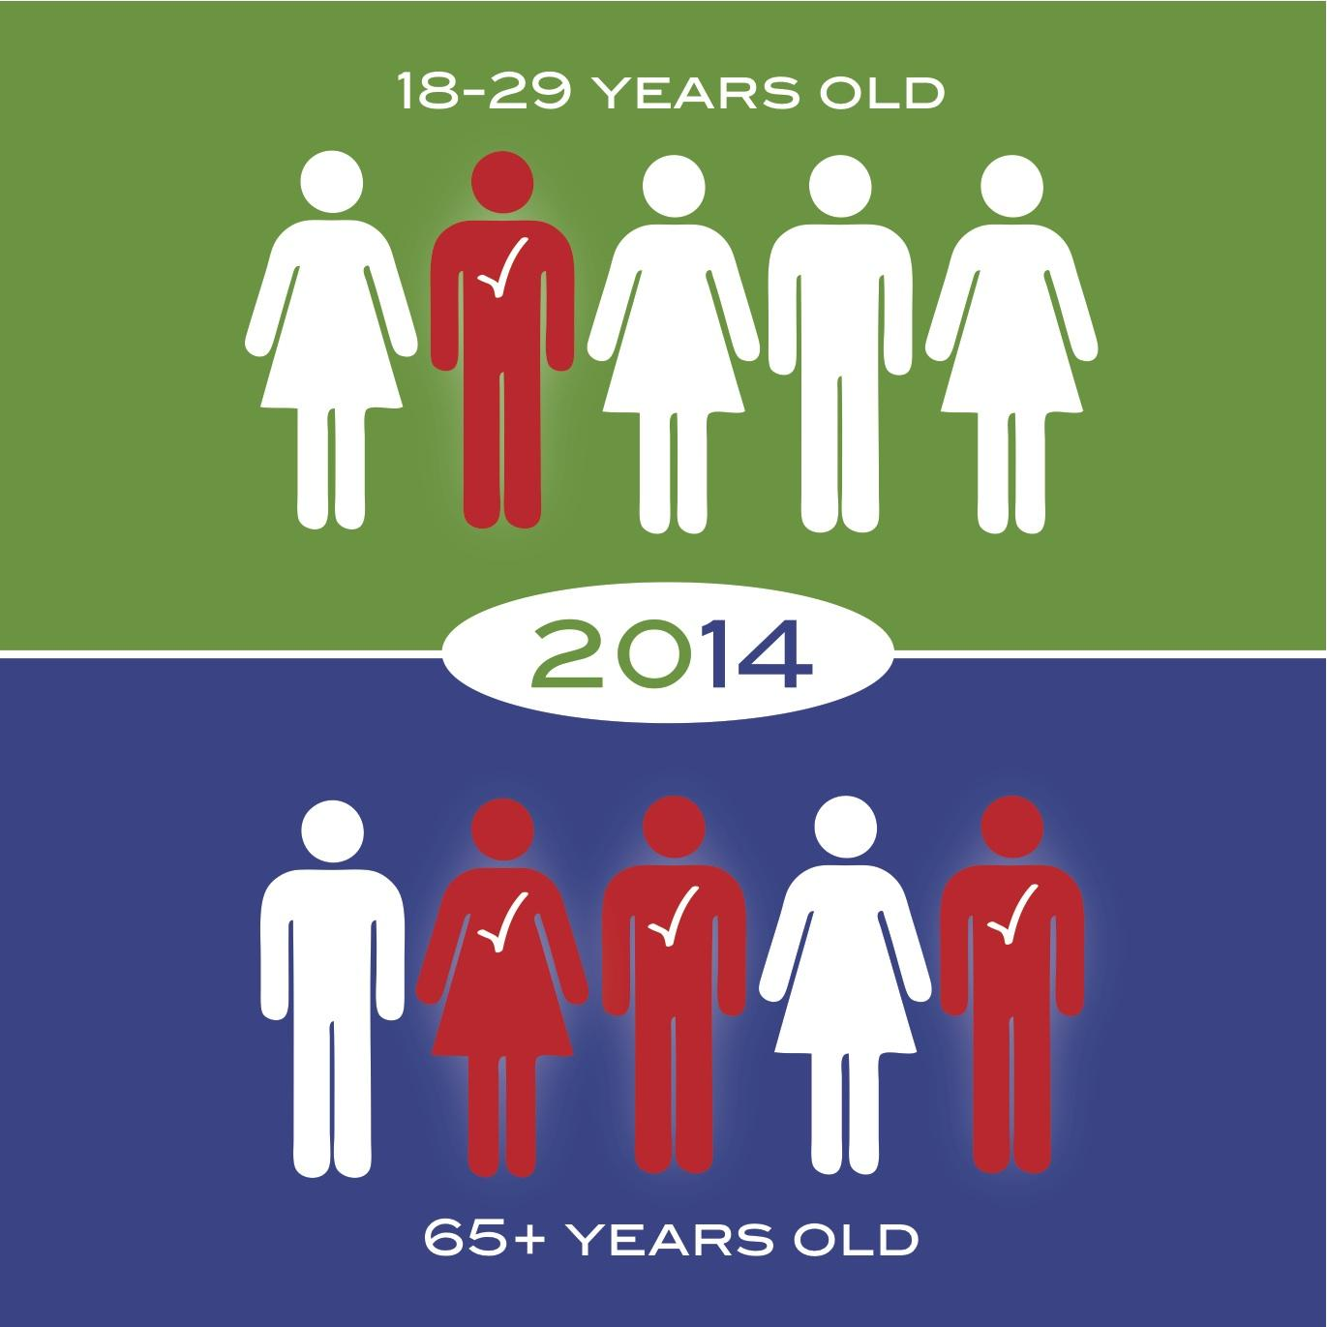
Let’s talk about Young Voters...
Young Adult Voter Turnout
2008: 51%
2012: 45%
2014: 20%
2016: 50%
24 million young adults who could have voted, didn’t vote!
Notes:
“We have the power to change these statistics… TODAY!”

Slide 4
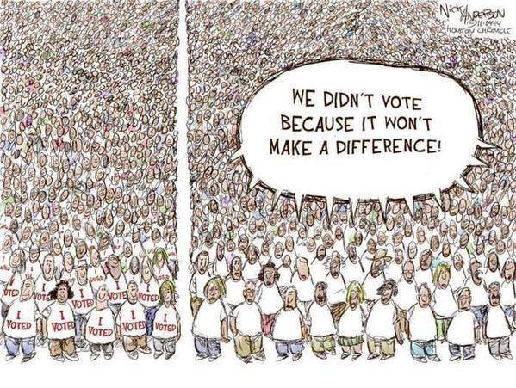
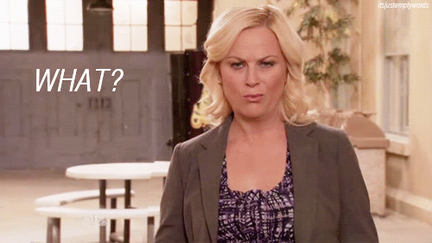
Review the math...
Notes:
When people don’t vote, their voices aren’t heard.

Slide 5
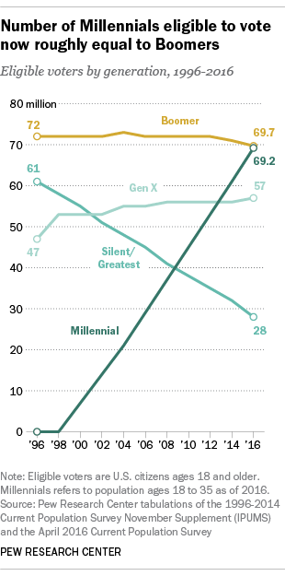
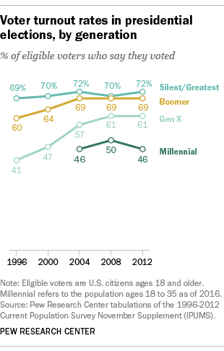
Power in NUMBERS!
18-29 year olds represent the largest segment of the U.S. population.
= Power to Impact
BUT they must…
Register to vote
Become informed
Vote

