Slide 1
MobileServe
Track you service with the Kentucky YMCA!

Slide 2
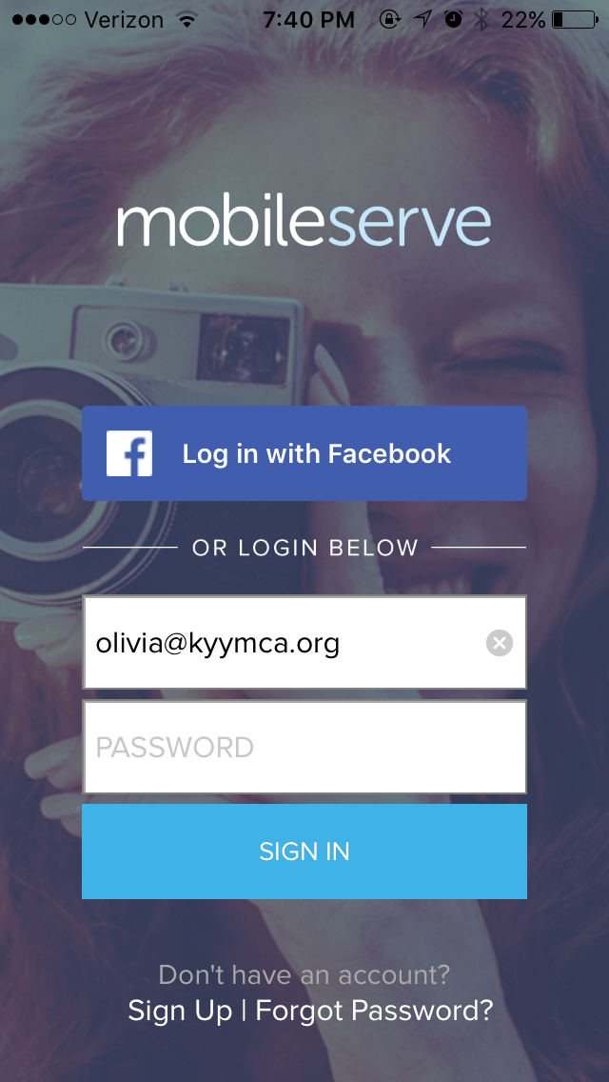
Step 1: Login/Create Account
Login to account
Having trouble logging in?
Let us know and we will try to help from the back end of the app
Use an email you will check, so should you ever need assistance, MobileServe can contact you

Slide 3
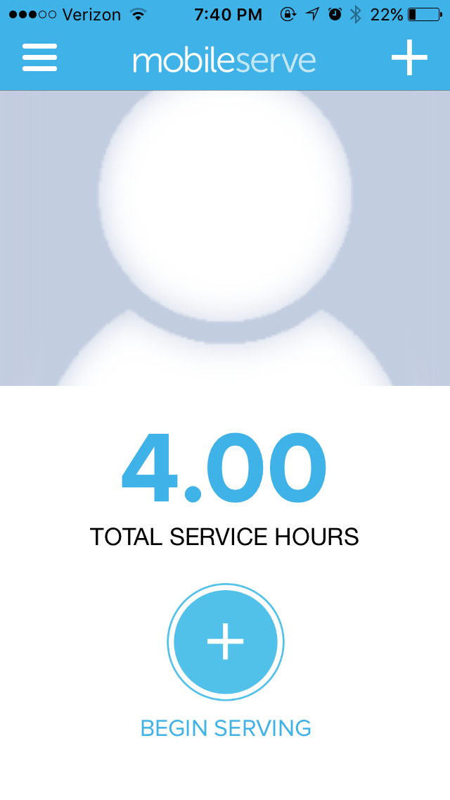
Step 2: Select “Begin Serving”
The number you see at the top of this screen is your total hours to date.
You will select the symbol with the plus sign to begin adding your new service hours.

Slide 4
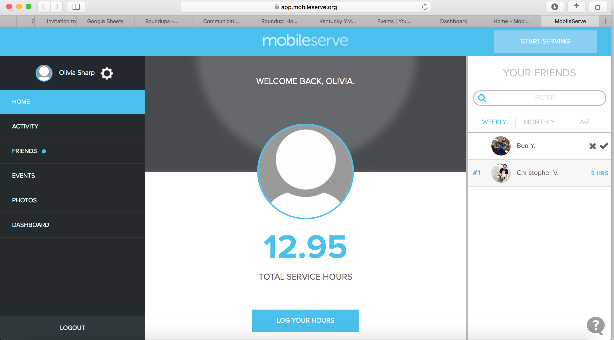
Step 2: Select “Begin Serving”

Slide 5
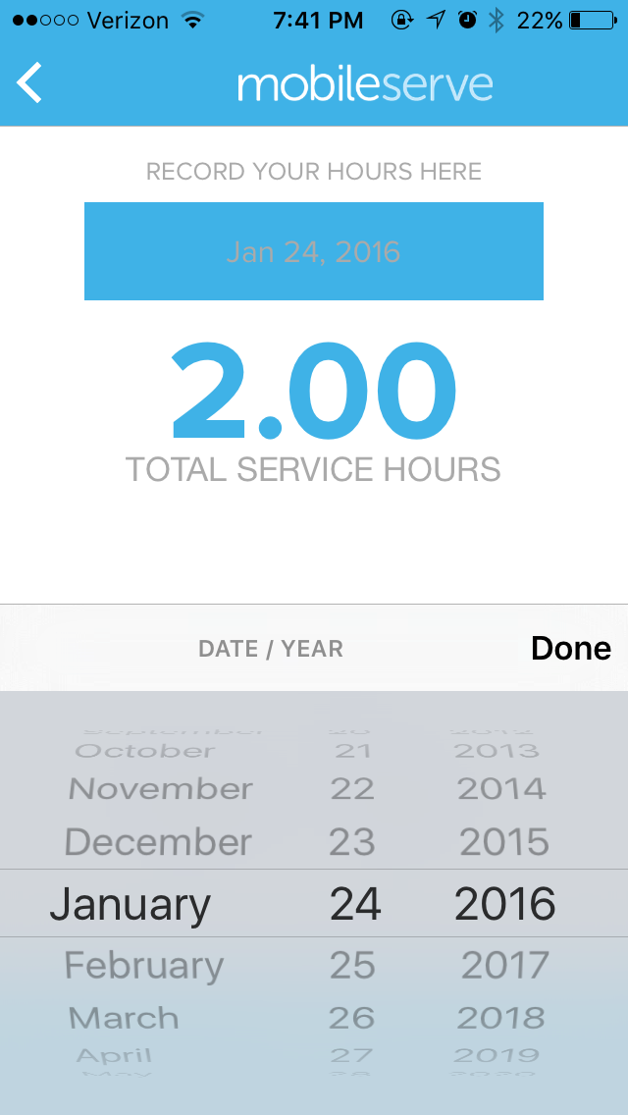
Step 3: Select Service Date
The date is automatically set to the day you are logging
You can back-log hours from a previous service project
When backlogging, just simply click the date, and change it to the date the service occurred
You cannot forward log hours

Slide 6
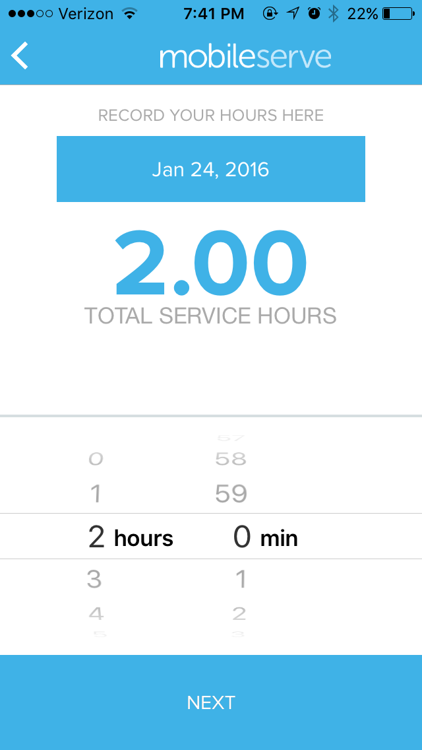
Step 4: Select Number of Hours
You can select the number of hours AND minutes you served
This allows you to be as accurate on your service tracking as possible
Because MobileServe does not track number of items, in the event of a drive, you and your club can come up with a standard for hours
i.e. 10 cans collected = 1 hour

Slide 7
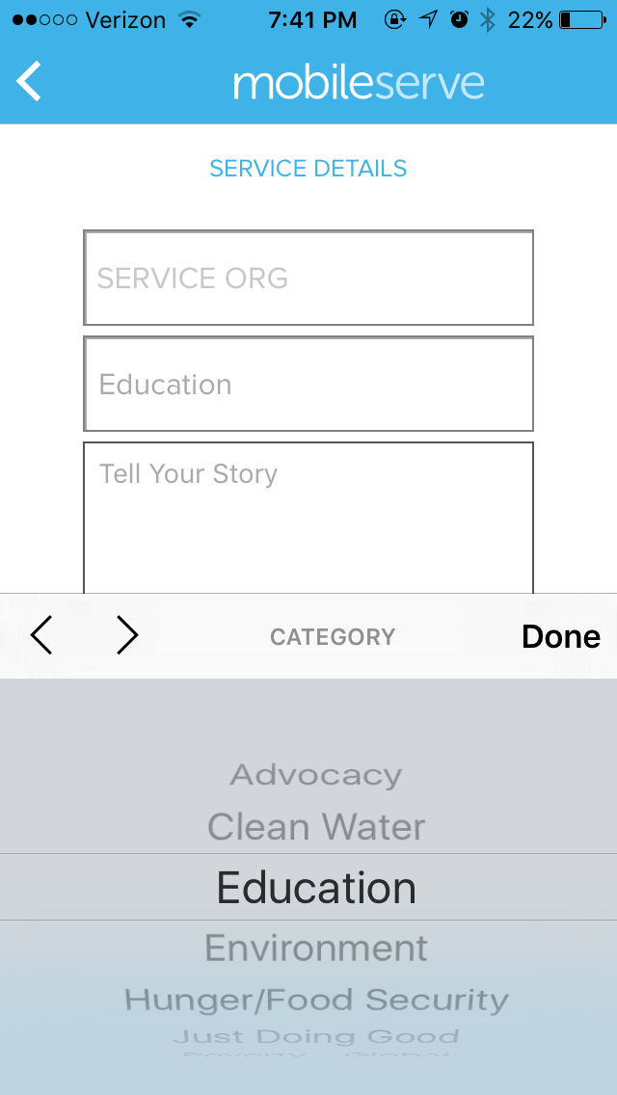
Step 5: Select the Service Category
There are an array of categories, based off the most recognized service areas by Youth Serve America and We Day
Categories include: Advocacy, Clean Water, Education, Environment, Hunger/Food Security, Poverty – Local, Poverty – Global

Slide 8
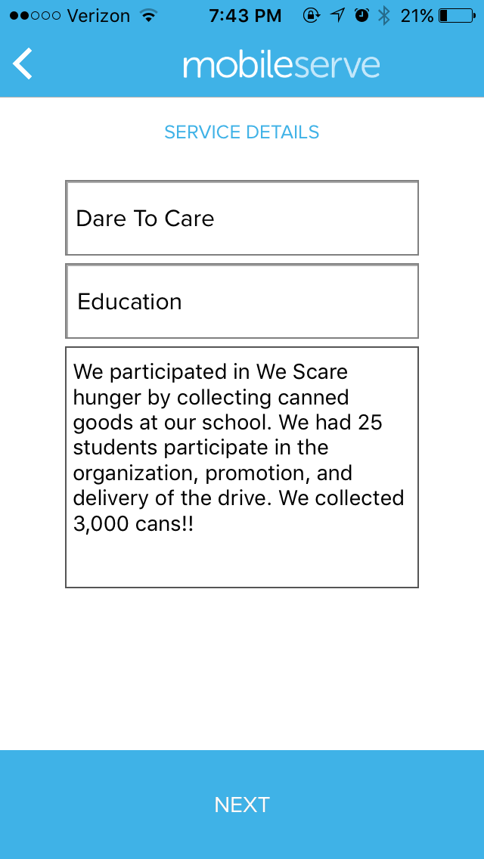
Step 6: Tell Your Story
Tell us the whole story!
Let us know the organization you served
This will be the benefitting organization, NOT your school or the program you are earning hours for.
Give us the details!
We want to know the who, what, and why of your service! Especially numbers so we can share your success with the community!

Slide 9
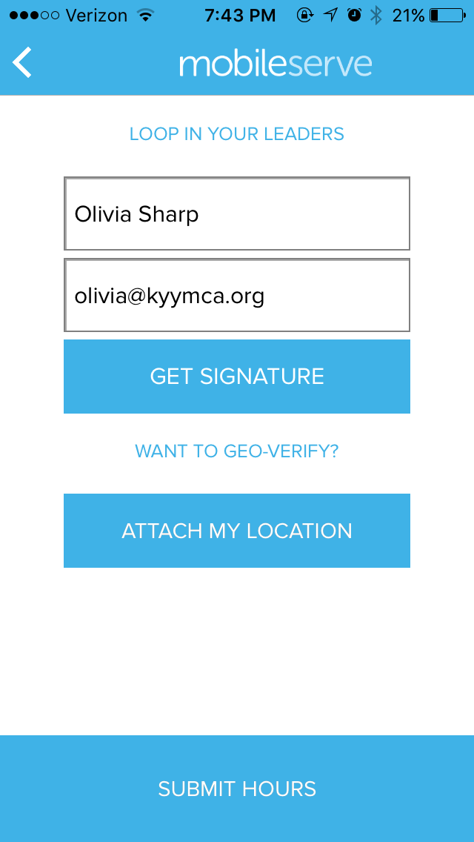
Step 7: Verify Your Hours
Completing hours for your We Day ticket? Student Y chapter points? Candidacy? Y-Corps? No problem!! Just attach your supervisor for that area and get your hours verified!
You can also attach your location on this page for additional verification of your service site!

Slide 10
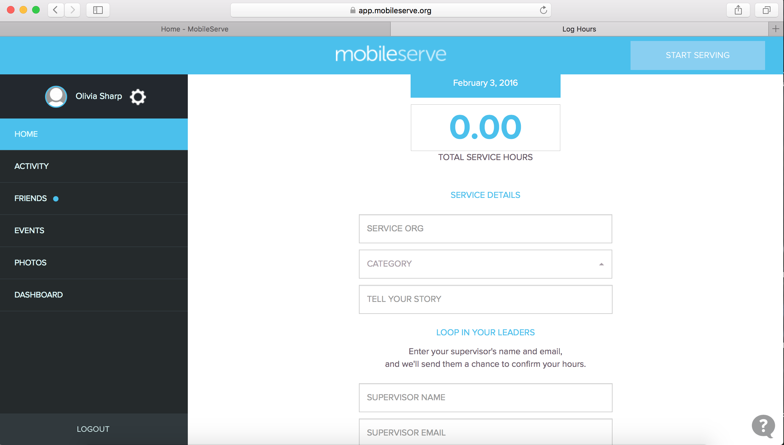
Step 7: Verify Your Hours

Slide 11
Step 7: Verify Your Hours
- Want to verify your hours on site? Still no problem at all! Pull up the signature page to get your site supervisor’s signature on the spot!

Slide 12
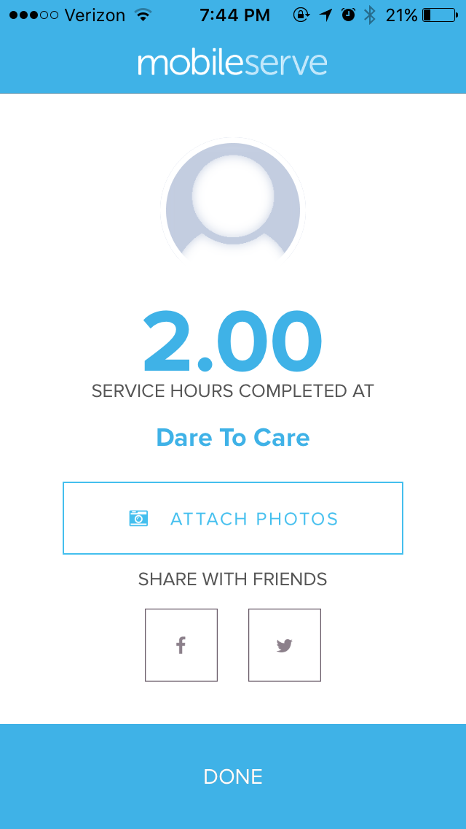
Step 8: Share it with the World!
Don’t just share your service with the Y, share it with the world!
MobileServe allows you to post your service accomplishments and photos directly to your social media accounts.
Share your service, and inspire those around you to up their service game as well!

Slide 13
Step 8: Share it with the World!
Use hashtags to accompany your service tracking!
Hashtags will help you share the service you are doing in a social-media friendly way, as well as allow KYYMCA Staff and We Day Kentucky Staff to see the great projects you guys are doing!
Some suggested hashtags include:
#ycorps2016
#endorsedproject
#ivoted
#KYA & #KUNA
#wedaylocal
#wedayglobal

Slide 14
Questions? Concerns?
How can I help?
How has your experience been so far?
Let’s log an advocacy hour, right now!

